Slide 1
Silver Oak Collage Of Engineering and Technology
Project Title : Travel Advisor
Team ID : 1014
Project Type : UDP
Team Members: Gandhi Hitarthi D.
Bhatt Charmi B.

Slide 2
Content of Presentation
Introduction
Objectives
Related Background
Tools & Technology
Modules
Snapshots of website

Slide 3
Introduction
Travel Advisor is a website where people can find a different travel agencies.
We are offering to people with best services of different travel agencies of India which inform you regarding different trips in India as well as trip schedule.
They also find their trip schedule under them budget.
So Travel advisor is a smart system where you can easily find travel organizer.

Slide 4
Objectives
User easily find hotel and different places online but they can’t find full arrange trip.
If people wants to go with any trip through travelers then they visit different-different travel agency personally and its take too much time so here we provide the platform to overcome this problem.

Slide 5
Here we provide travelers to available travel agencies details based on users budget and using them user will choose satisfied package.

Slide 6
Related Background
Summary of Trip Advisor:
Trip Advisor, Inc., is an American travel website company providing hotels booking as well as reviews of travel-related content. It also includes interactive travel forums.
Trip Advisor was an early adopter of user-generated content.
The website services are free to users, who provide most of the content, and the website is supported by a hotel booking facility and an advertising business model.

Slide 7
Trip Advisor, the world's largest travel site*, enables travelers to unleash the full potential of every trip.
Trip Advisor provides travelers with the wisdom of the crowds to help them decide where to stay, how to fly, what to do and where to eat.
Trip Advisor also compares prices from more than 200 hotel booking sites so travelers can find the lowest price on the hotel that's right for them.
Trip Advisor: Know better. Book better. Go better.

Slide 8
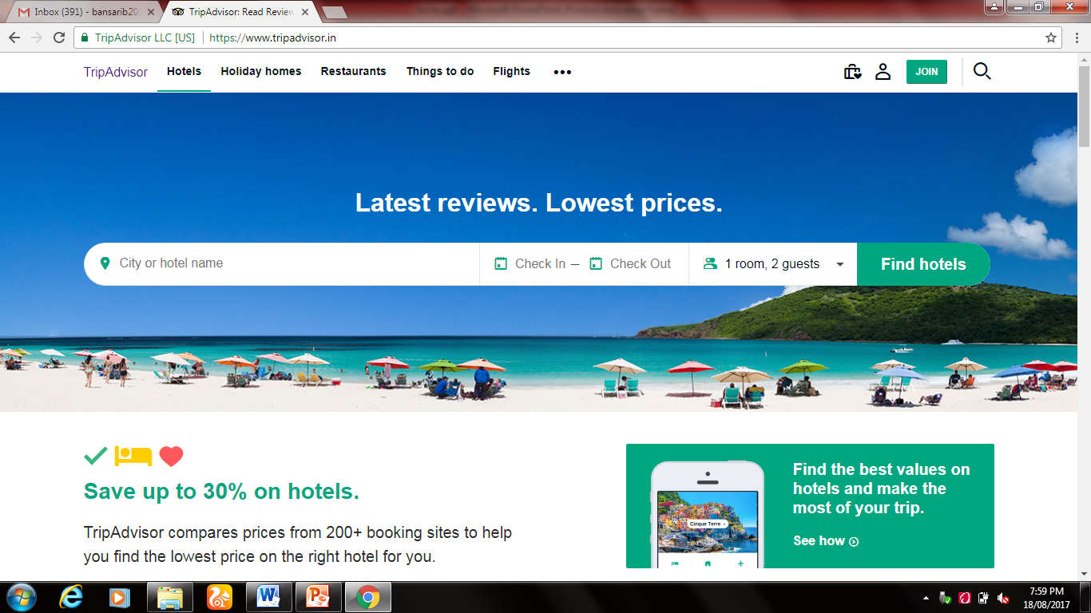

Slide 9
Summary of Trivago:
Trivago is a hotel search with an extensive price comparison.
The prices shown come from numerous hotels and booking websites.
This means that while users decide on Trivago which hotel best suits their needs, the booking process itself is completed through the booking sites.

Slide 10
Trivago’s hotel search allows users to compare hotel prices in just a few clicks from more than 200booking sites for 1.3 million hotels in over 190 countries.
With 1.4 billion visits annually to our site, travellers regularly use the hotel comparison to compare deals in the same city.
Get information for weekend trips to cities like Mumbai or Bengaluru and you can find the right hotel on trivago quickly and easily. Delhi and its surrounding area are great for trips that are a week or longer with the numerous hotels available.

Slide 11
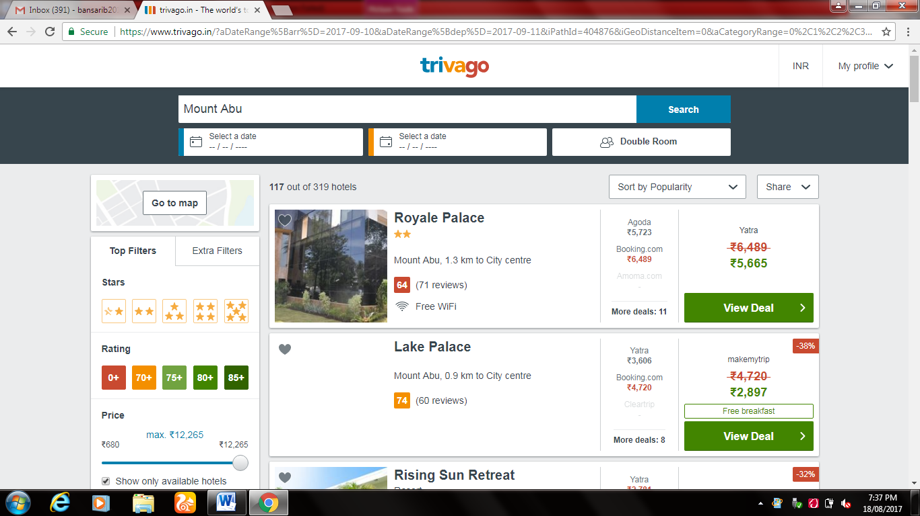

Slide 12
Tools & Technology
Tools Used:
Microsoft visual studio
Microsoft visio
Technology Used:
In our project we use .NET,HTML,CSS for implementation of our project.

Slide 13
Modules
Admin module
The search history are managed by admin and also admin is responsible for what details are shown. He is responsible for managing different tasks.
User module
User can see the list of agencies. Also gives suggestions. They can give feedbacks about services.

Slide 14
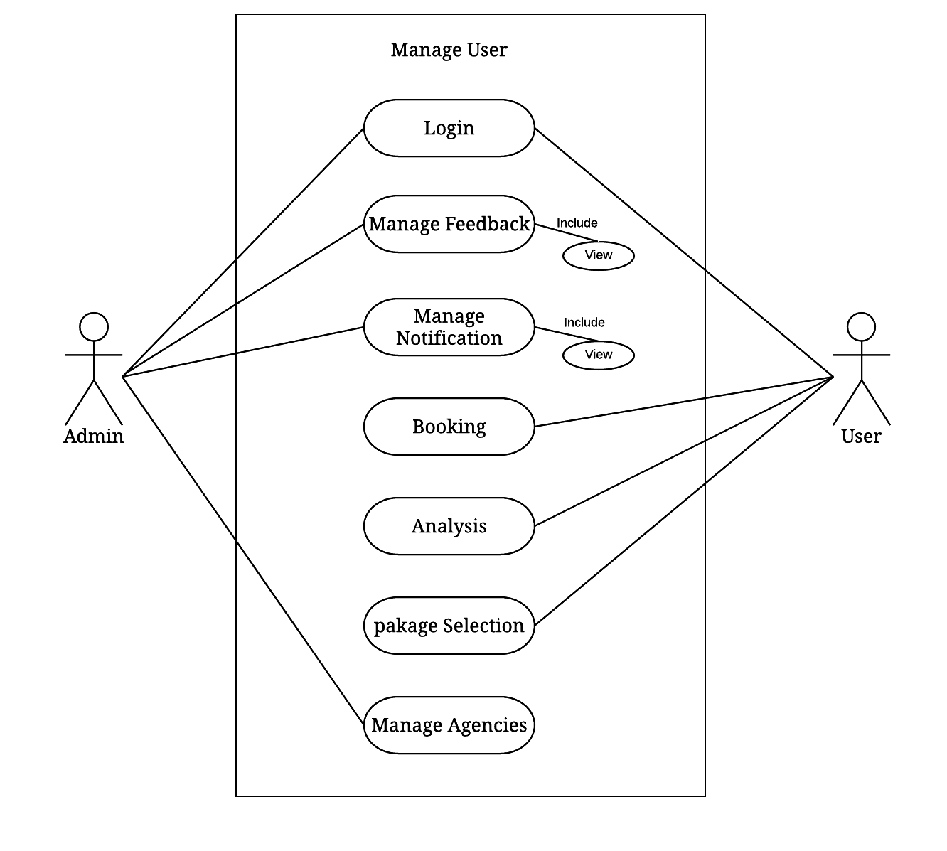
System Design
Use case Diagram :

Slide 15
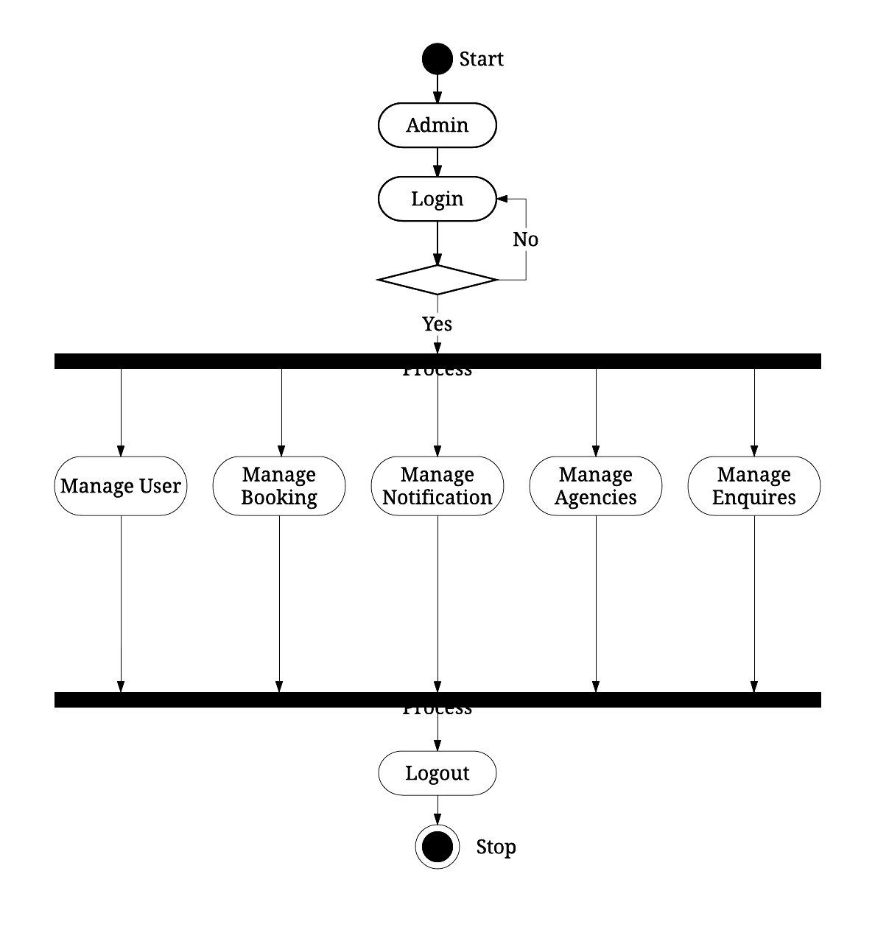
Activity Diagram :
Admin:

Slide 16
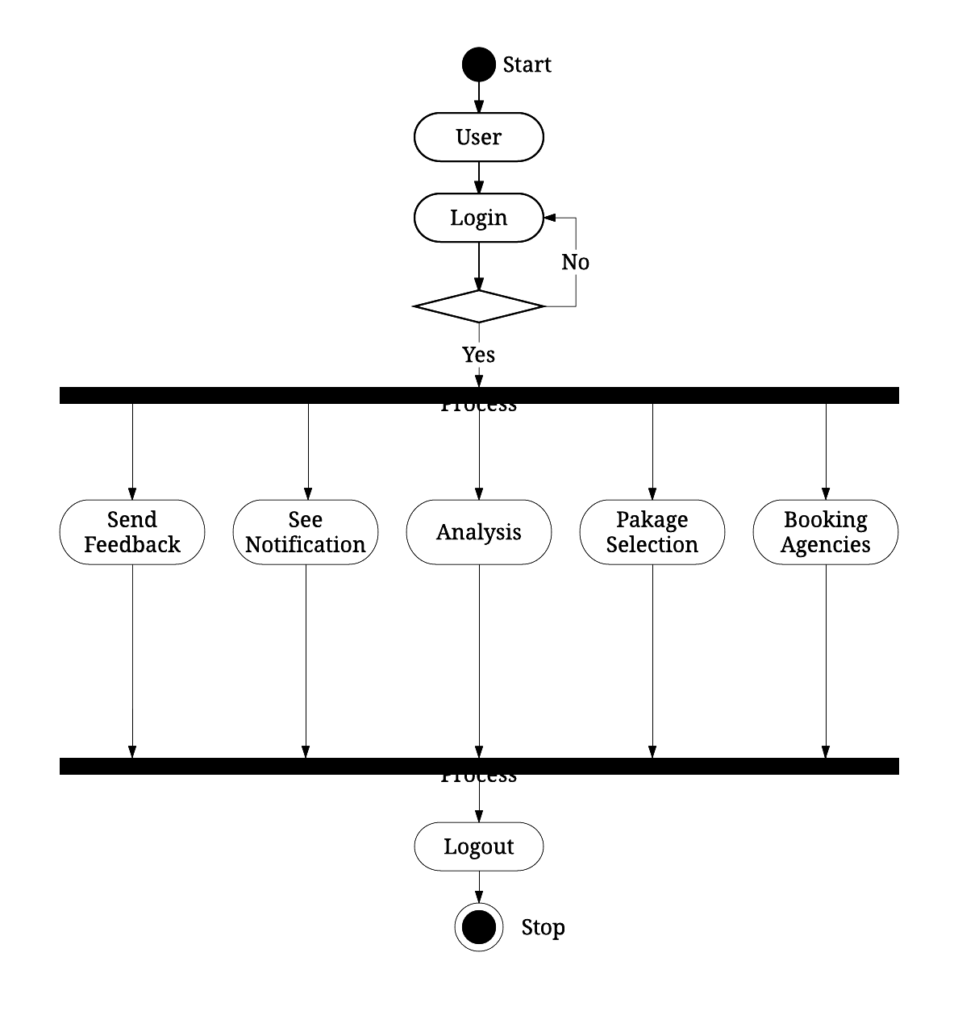
User

Slide 17
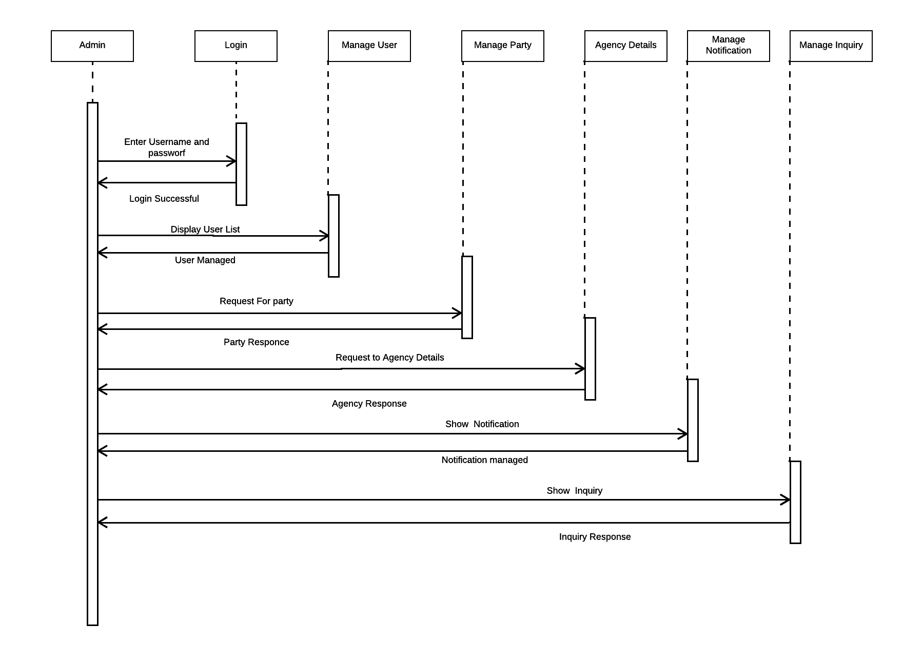
Sequence Diagram :
Admin:

Slide 18
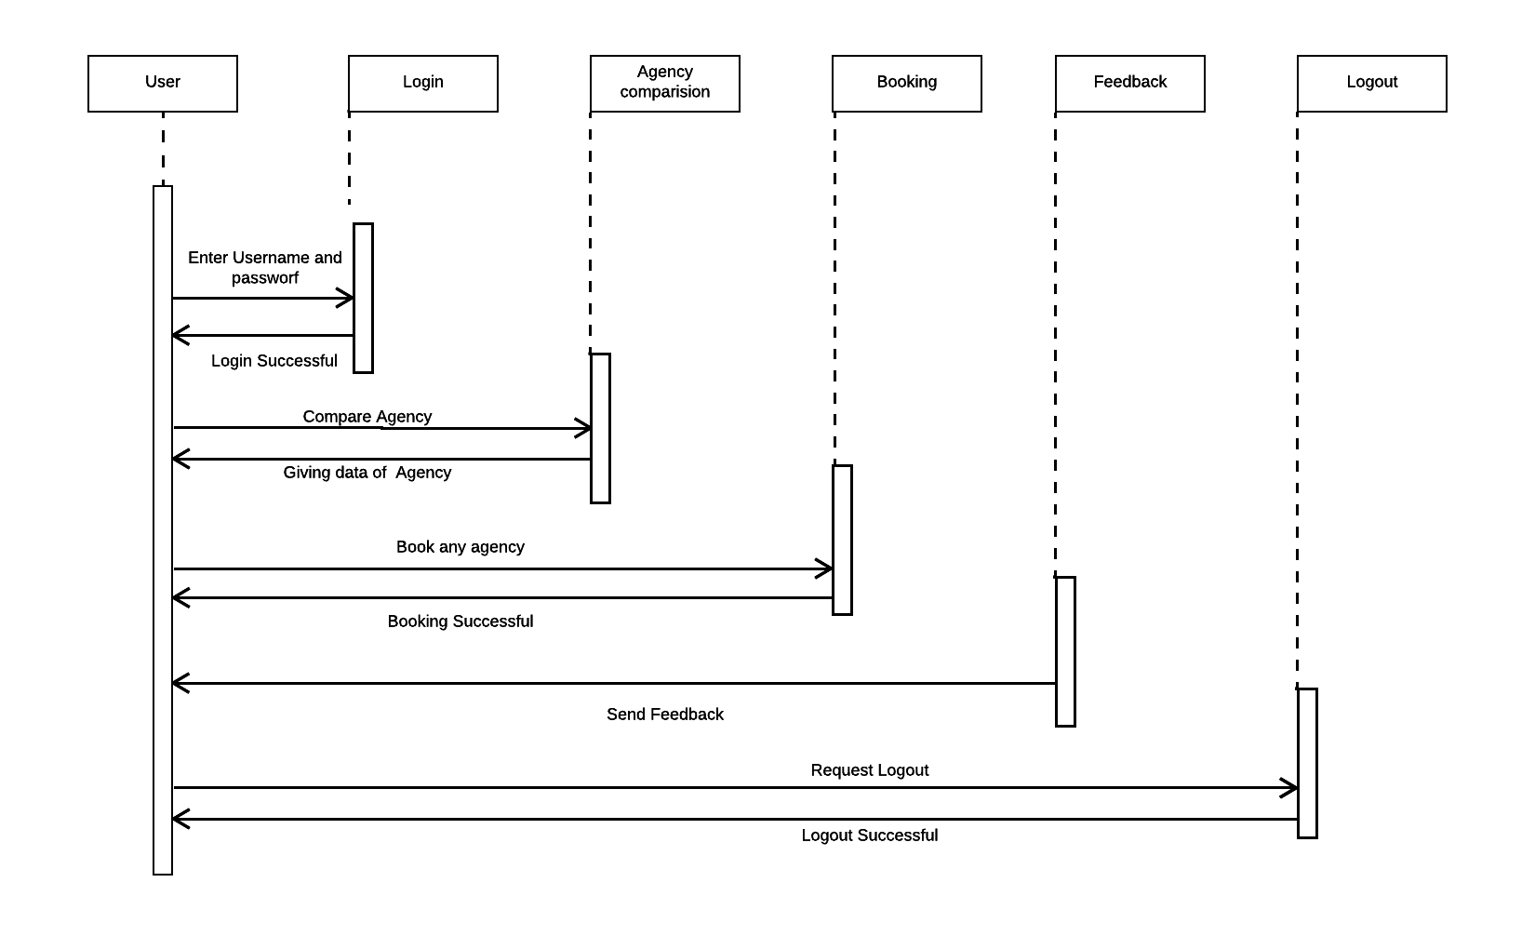
User:

Slide 19
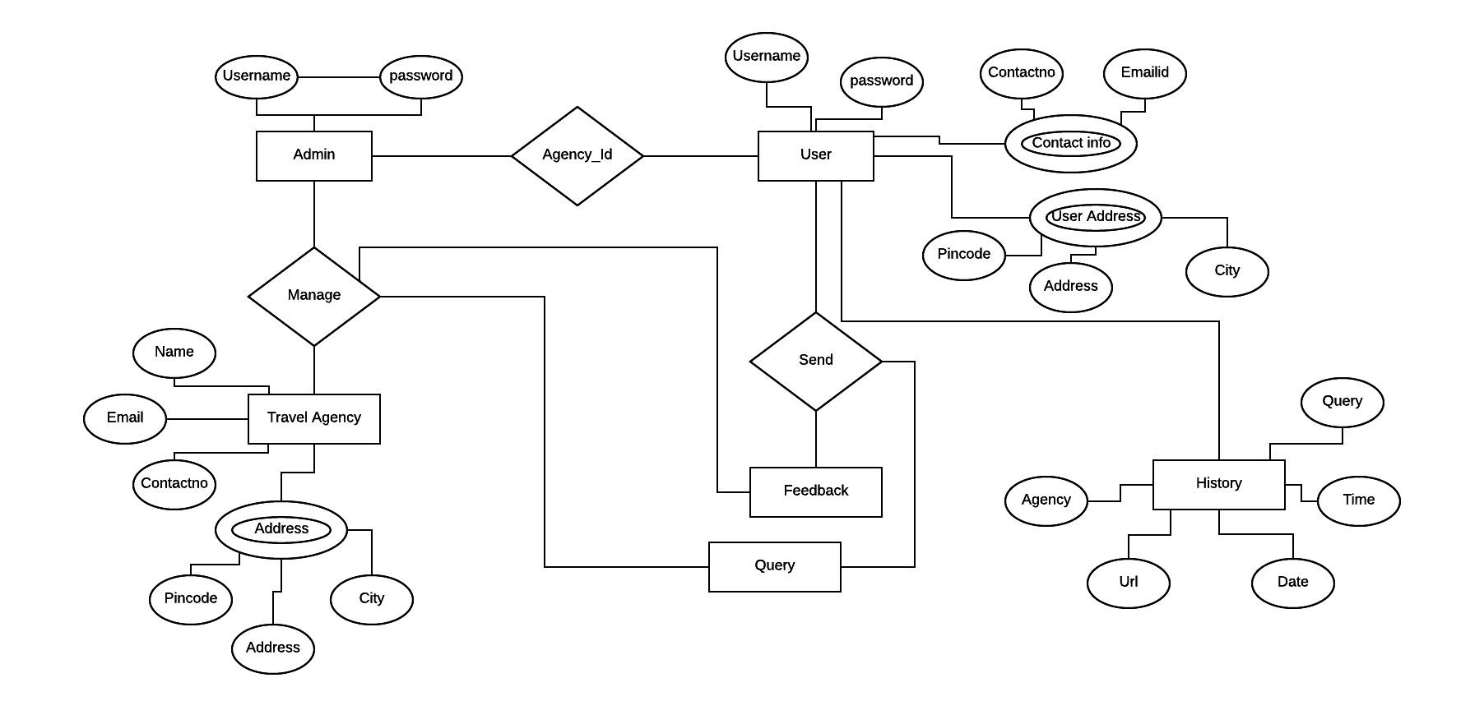
E-R Diagram :

Slide 20
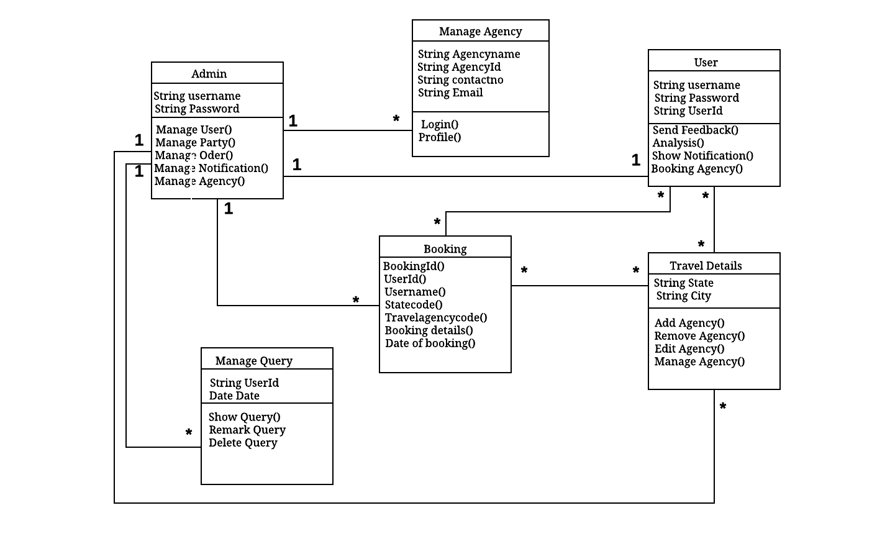
Class Diagram:

Slide 21
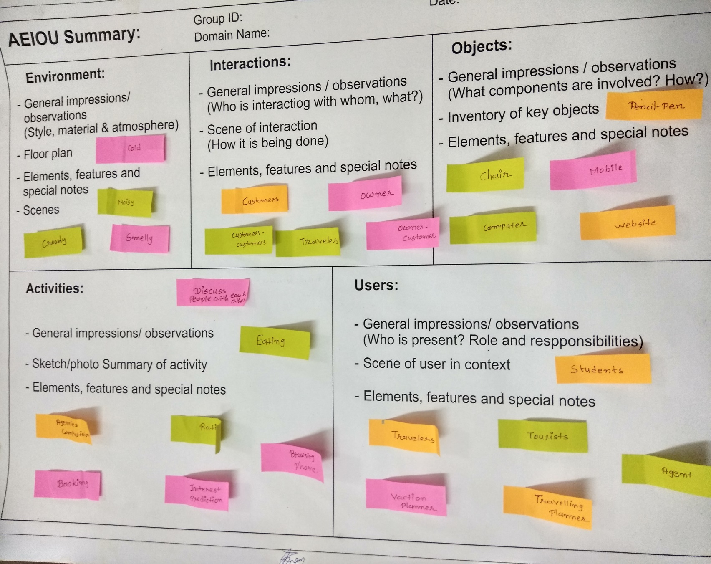
AEIOU Sheet

Slide 22
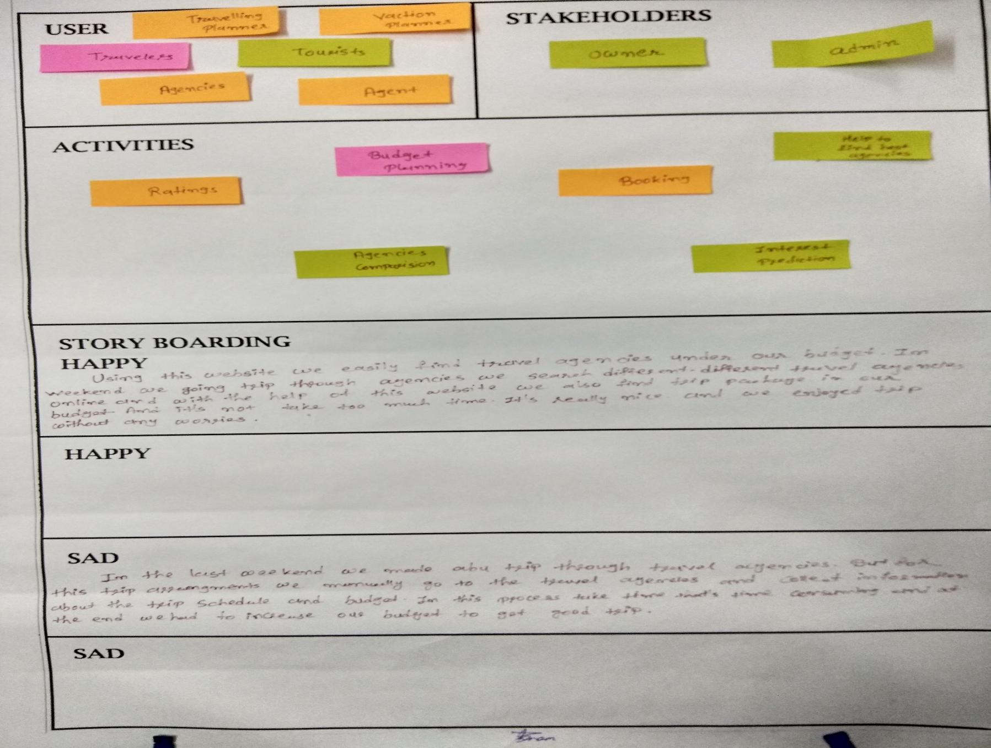
Empathy Mapping Canvas

Slide 23
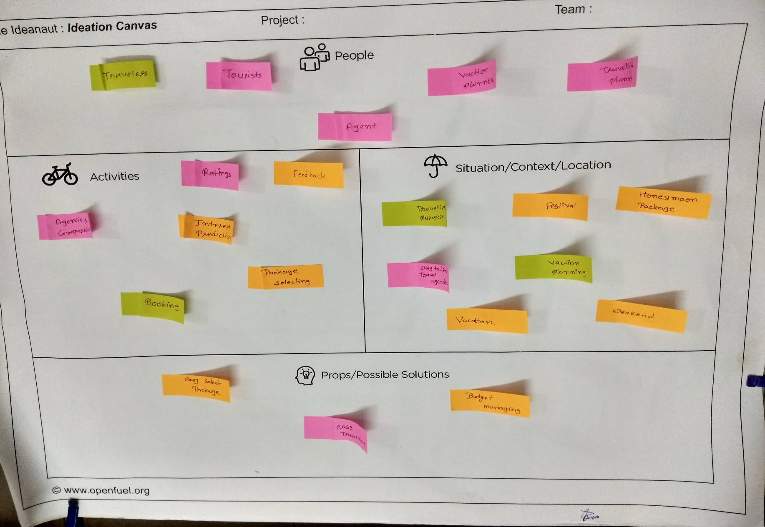
Ideation Canvas

Slide 24
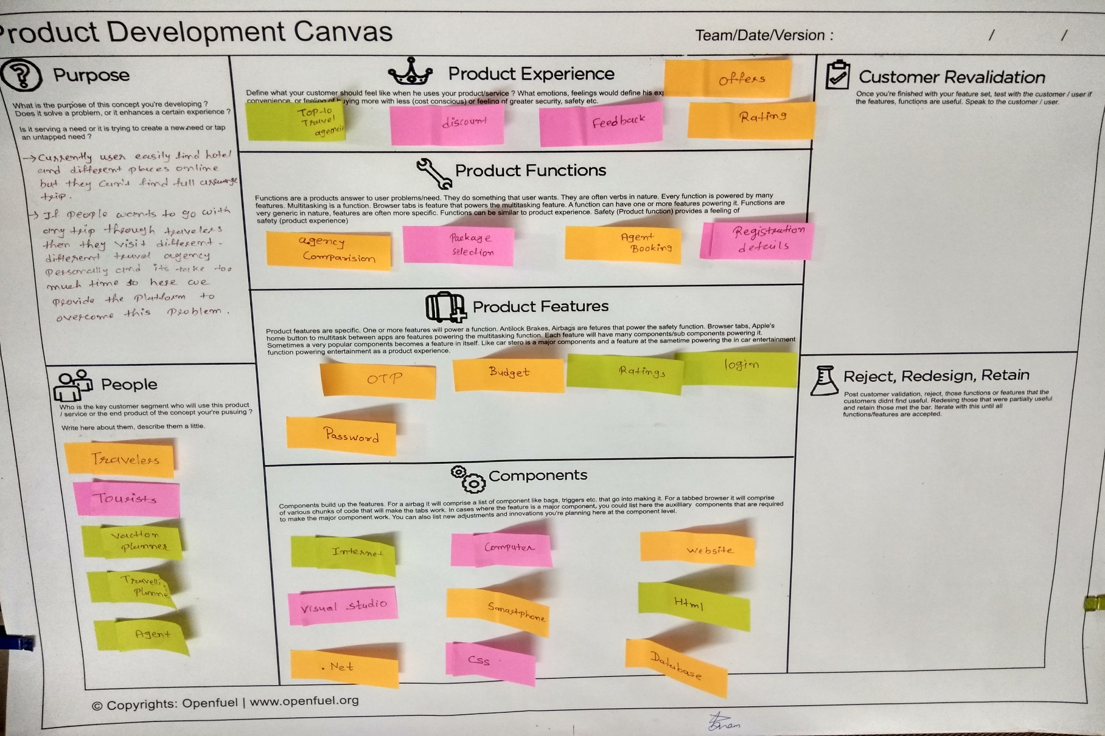
Product Development Canvas

Slide 25
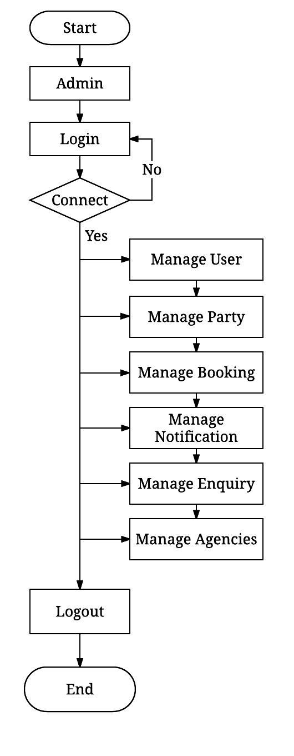
Flow Chart
Admin

Slide 26
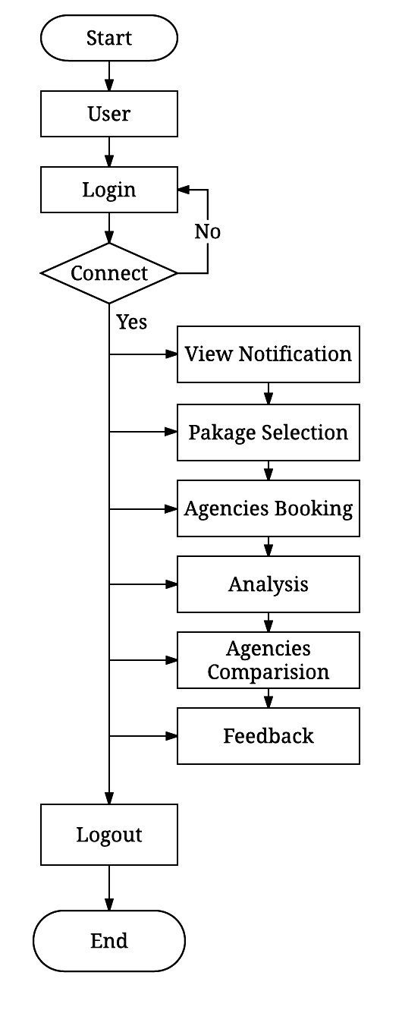
User

Slide 27
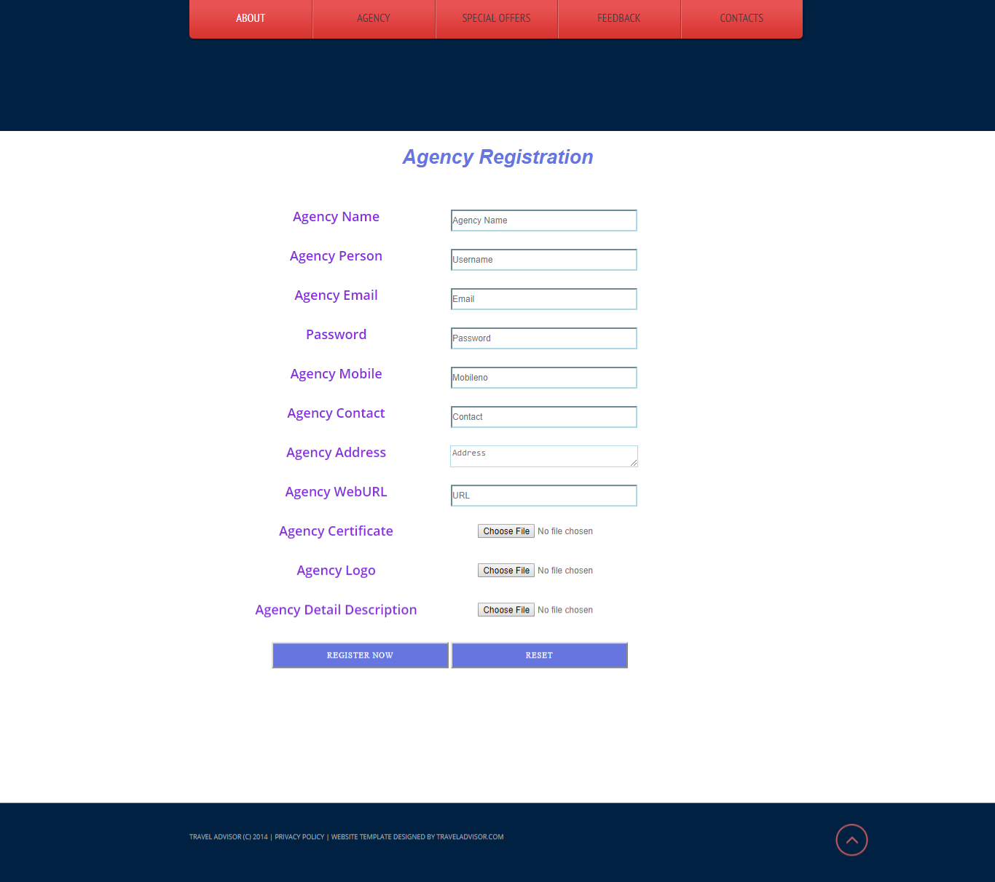
Screenshots of website

Slide 28
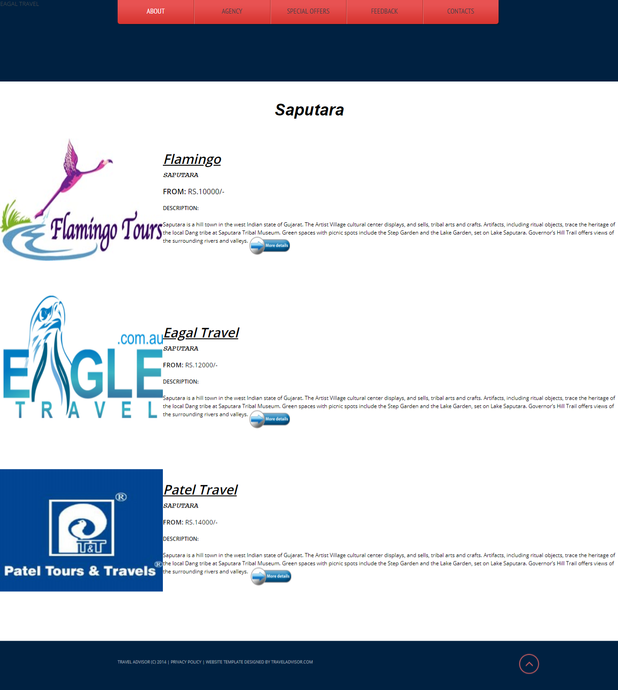

Slide 29
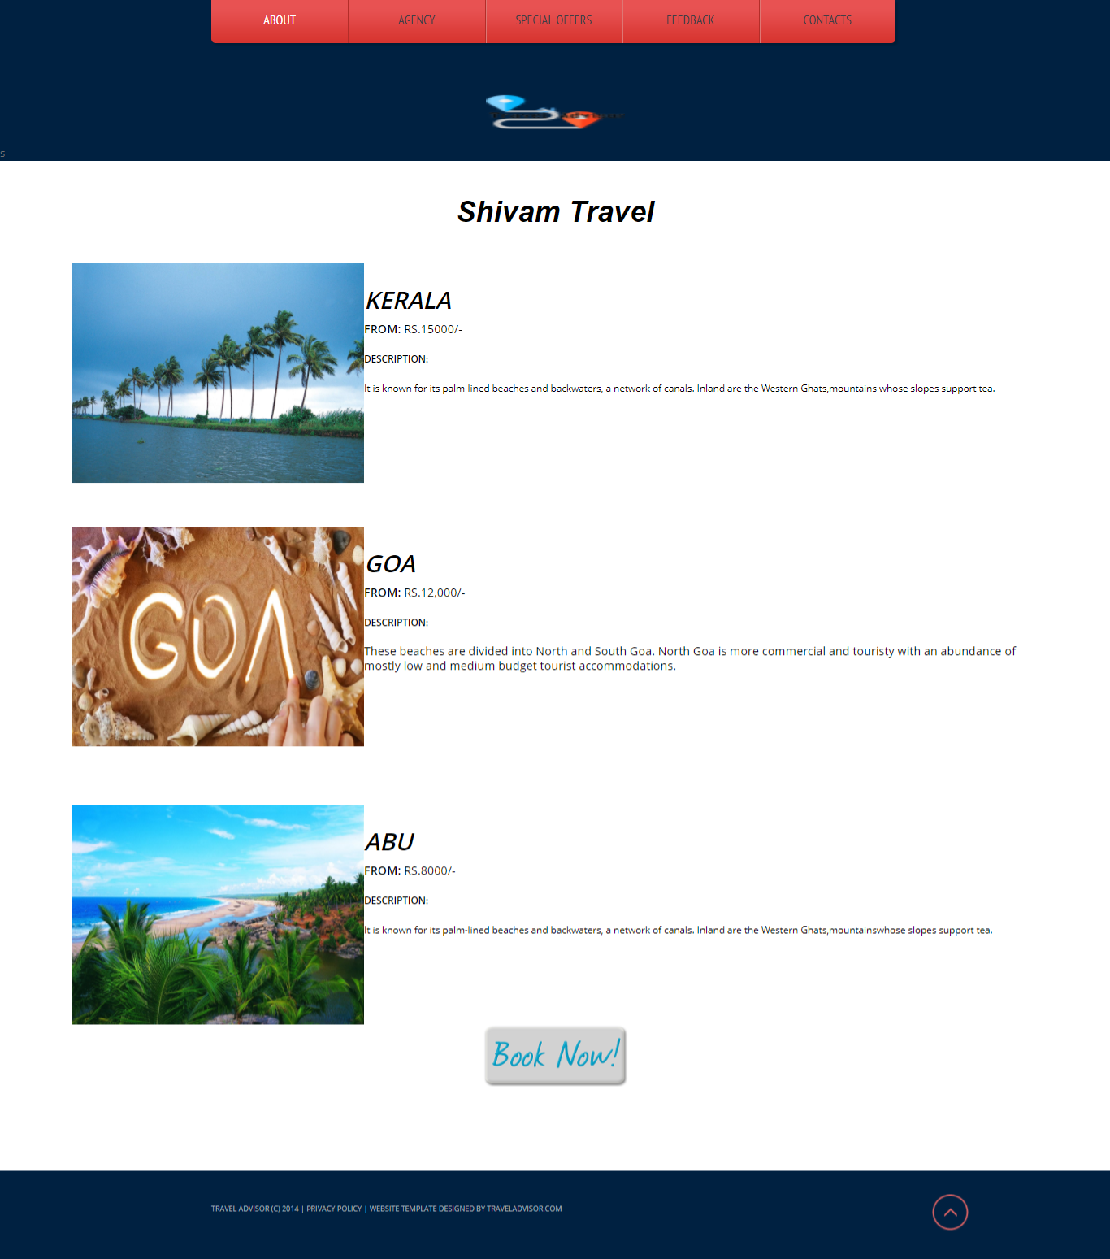

Slide 30
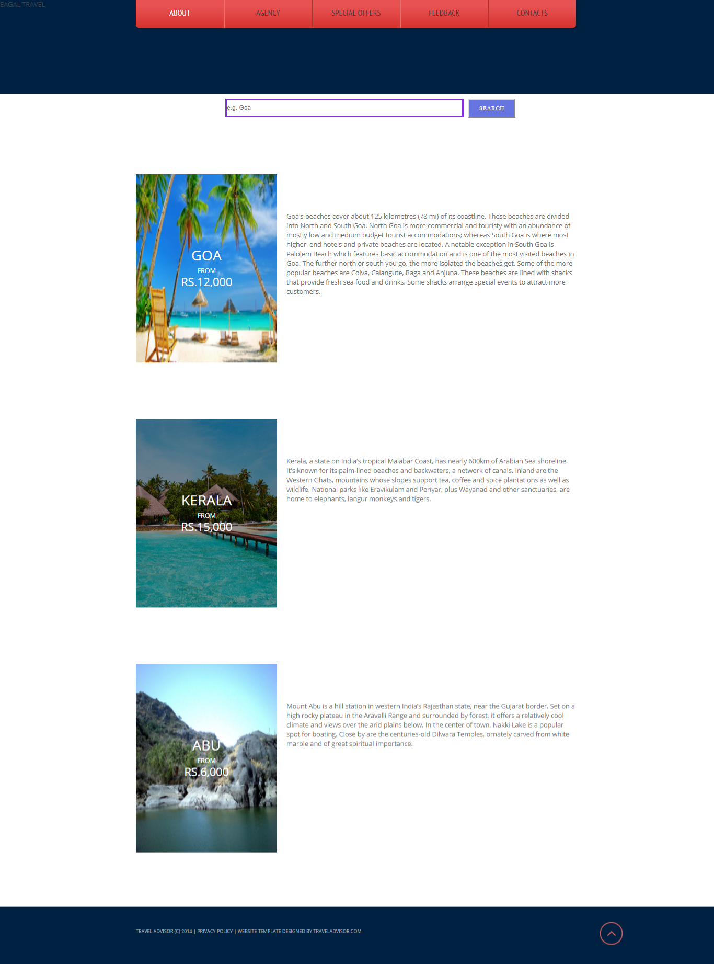

Slide 31
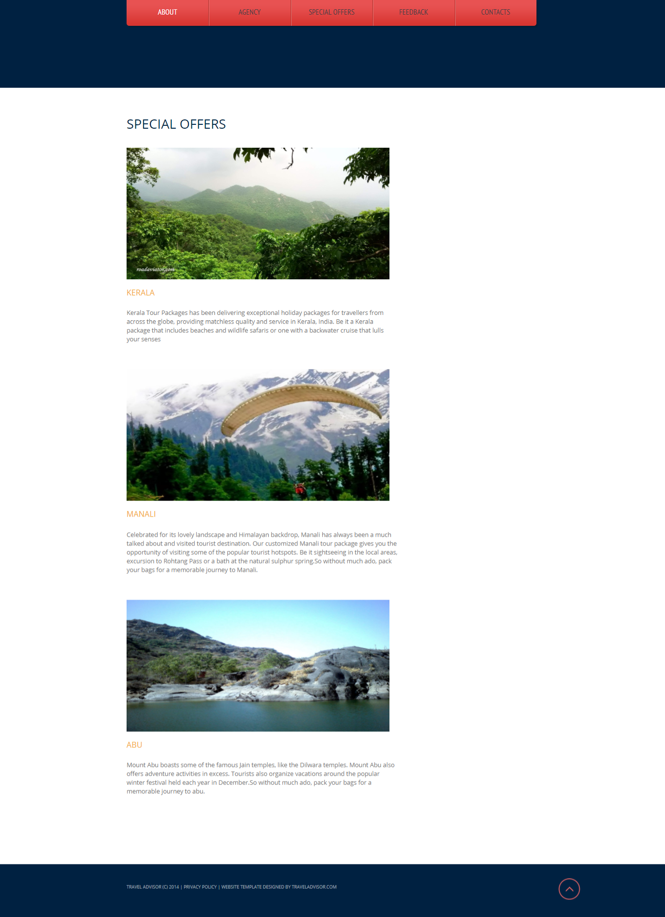

Slide 32
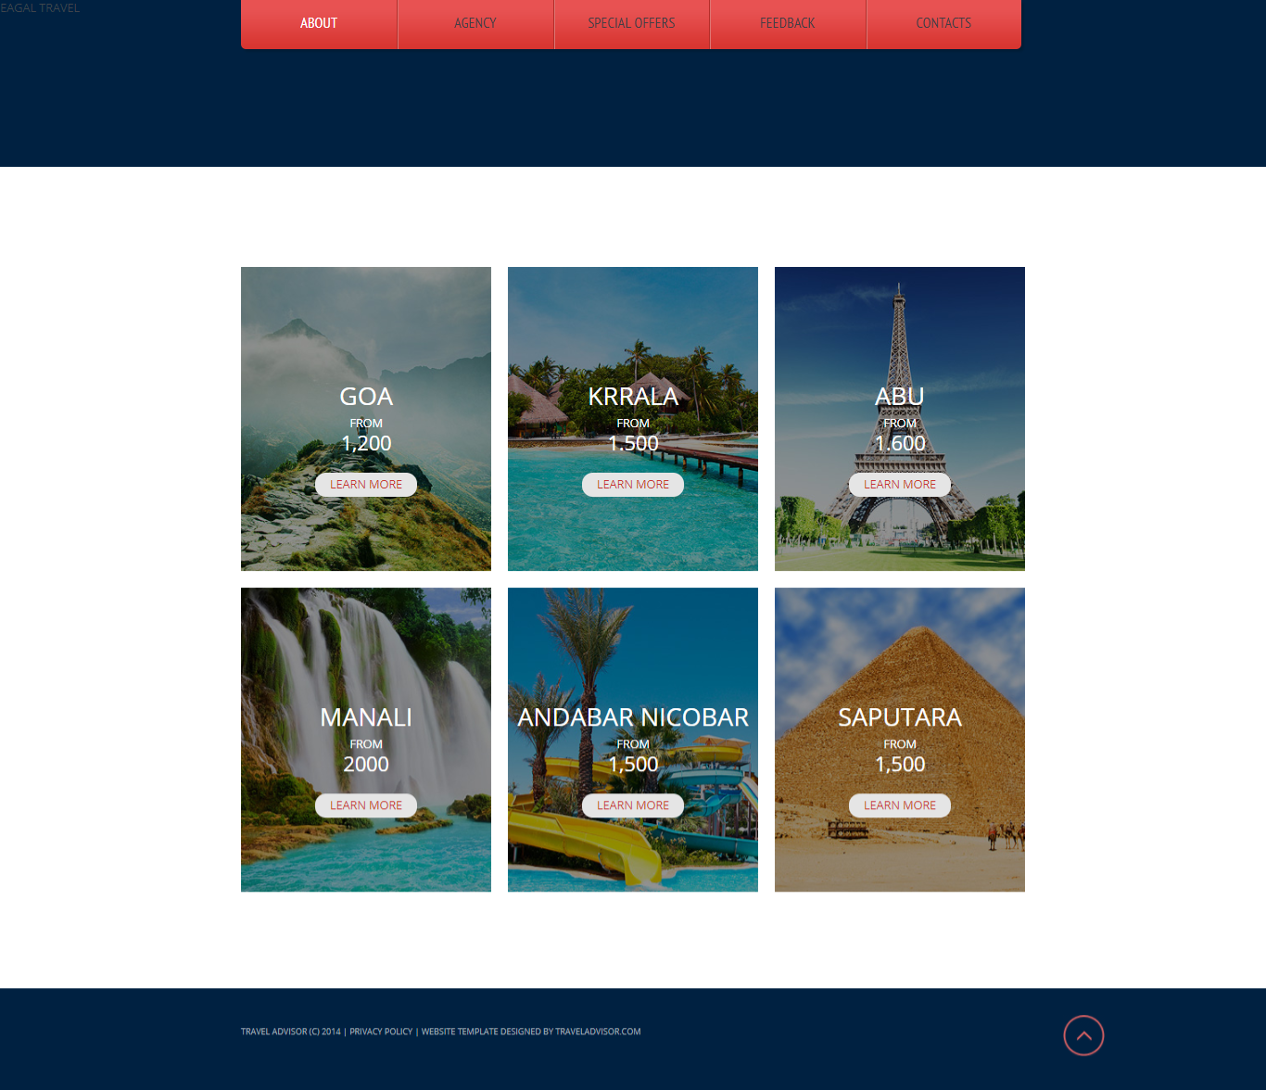

Slide 33
Thank You…

